Slide 1
Willson Financial Database Solution
CSD-310 Database Development and Use
Milestone #5 – Revised Case Study Presentation
Group Bravo
Justin Bradley • Natalia Carbajal • Blaise Johnson • Luis Rodriguez
Aug 2, 2026
Notes:
Hello everyone. We are Group Bravo. This presentation covers our final database solution for Willson Financial, including the case study, final ERD, business rules, reports, report examples, assumptions, and overall project results.

Slide 2
Group Introduction
Group Bravo worked together to design, build, and test a relational database solution for Willson Financial.
The project combined database design, MySQL, SQL reporting, and Python.
Our final solution focuses on keeping client information organized and making important business information easier to retrieve.
2
Notes:
Our group worked through the project in stages. We first identified the data the company needed, created the relationships, built the database, and then developed reports that use the stored information.

Slide 3
Case Study Overview
Willson Financial needs to manage information about clients and the employees who work with them.
The company also needs to track client assets, financial transactions, appointments, and billing.
Keeping this information in related tables reduces repeated data and gives employees one organized source of information.
The database also needs to support reports that can be used for client service and normal business operations.
Project Objective
Create a relational database that organizes the company's information, maintains useful relationships between records, and supports simple business reports.
Main Areas
Employees • Clients • Assets • Transactions • Appointments • Billing
3
Notes:
The main problem was organizing several types of information that are connected to the same clients. Our solution uses a relational database so the company can store that information without putting everything into one large table.

Slide 4
Business Rules
Employee & Client
One employee can manage multiple clients. Each client is assigned to an employee.
Assets & Transactions
A client can have multiple assets and transactions. A transaction may reference a specific asset.
Appointments
Clients can have multiple appointments. Each appointment records the client and employee involved.
Billing
A client can have multiple billing records. Each record stores the amount, date, and payment status.
Database Integrity
Primary and foreign keys connect related records and help prevent inconsistent relationships.
4
Notes:
These rules guided our table relationships. They helped us decide where foreign keys belonged and which relationships were one-to-many.

Slide 5
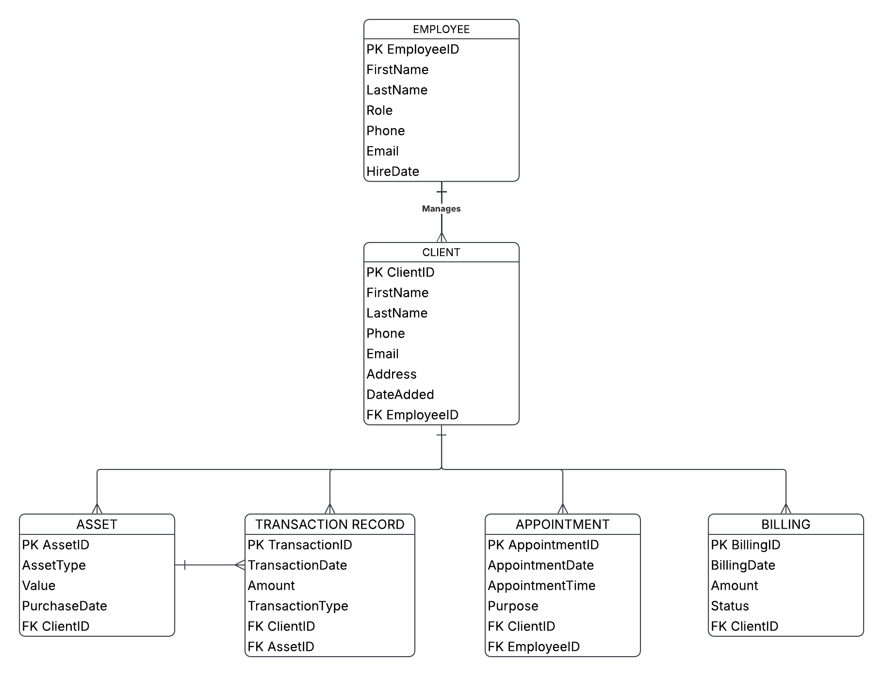
Final Entity-Relationship Diagram (ERD)
Separate tables are used for employees, clients, assets, transactions, appointments, and billing.​
Primary keys uniquely identify records in each table.​
Foreign keys connect related information without repeating full client or employee details.​
The structure supports one-to-many relationships such as one client having many assets or billing records.​
Keeping the information separated by subject makes the database easier to update and query.​
5
Notes:
We chose this layout for our ERD because each table stores one type of information. The Employee table manages clients, while each client can have multiple assets, appointments, and billing records. Assets are connected to transaction records, allowing us to track activity without storing the same data multiple times. Primary and foreign keys link the tables together and maintain data integrity.

Slide 6
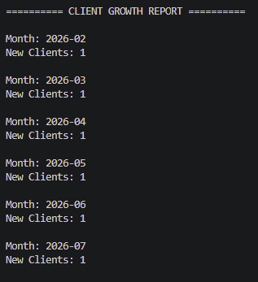
Report #1: Client Growth
Business Purpose
Shows how many new clients were added during the past six months. This helps:
Measure company growth
Evaluate marketing efforts.
Counts new clients added in each of the past six months.
Groups the count by signup month.
Shows the trend as the client base grows.
Answers the case study question on client growth.
7
Notes:
We chose this report because one of the case study questions asks how many clients were added in each of the past six months. It counts new clients by signup month, so the business can see how the client base is growing and gauge the results of its marketing efforts.

Slide 7
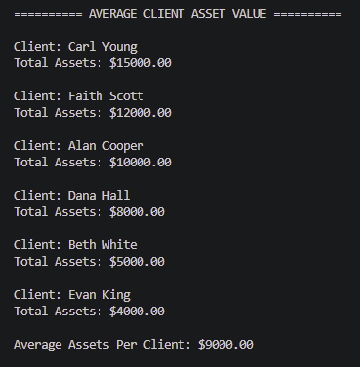
Report #2: Average Client Asset Value
Business Purpose
Reports the average asset value across the entire client list. This helps:
Gauge typical portfolio size and spot the largest holders.
Totals each client's asset value.
Ranks clients from highest to lowest total.
Averages those totals across the whole client list.
Answers the case study question on average client assets.
8
Notes:
We chose this report because the case study asks for the average amount of assets across the entire client list. It totals each client's assets, ranks them, and averages those totals, so advisors can see the typical portfolio size and identify the highest-value clients.

Slide 8
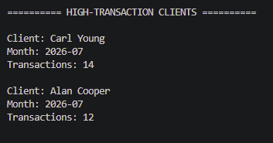
Report #3: High-Transaction Clients
Business Purpose : Identifies clients with more than ten transactions in a single month, so Jake and Ned can see the high-activity accounts at a glance.
This helps:
Flag heavy users for the billing-structure review
Spot which clients might warrant different pricing or service levels
Lists each client who exceeds ten transactions in a month
Shows the month and the transaction count
Sorted by volume, highest first
Answers the case study's high-transaction question directly
9
Notes:
This report answers the third case study question. It counts each client's transactions per month and flags anyone above ten. Carl Young and Alan Cooper both cross that line in July, which are exactly the kind of high-activity accounts Jake and Ned would examine when deciding whether to change the billing structure.

Slide 9
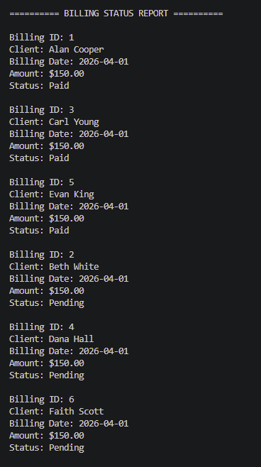
Report #4: Billing Status Report
Business Purpose
Show client billing records and make outstanding balances easier to identify.
Lists billing ID, client, date, and amount.
Displays whether the bill is Paid or Pending.
Makes pending accounts easy to identify.
Supports billing follow-up and record review.
9
Notes:
We chose this report because tracking billing status was one of the project's goals. It shows each client's billing information, including the amount, date, and payment status. This allows the company to quickly identify unpaid balances, follow up with clients, and keep billing records organized.

Slide 10
How the Reports Support the Business
Business Growth
Tracks new clients added over the past six months to measure company growth.
Asset Value Review
The average asset value report shows each client's total and the overall average to support portfolio review.
Transaction Monitoring
The high-transaction report flags clients with more than ten transactions a month for the billing-structure review.
Together with the billing status report, these show how one relational database supports different areas of Willson Financial's daily operations.
10
Notes:
We selected reports that represent different business needs instead of three reports that all answer the same type of question.

Slide 11
Assumptions Used During Database Design
Each client has one assigned employee at a time, but an employee can manage several clients.
Clients may own multiple assets and have multiple financial transactions.
A transaction does not always need an asset, but it can reference one when the transaction relates to a specific investment.
Appointments are stored separately so meeting information does not have to be repeated in client or employee records.
Billing records remain associated with the client and include a status such as Paid or Pending.
Historical records are kept so previous transactions, appointments, assets, and bills can still be reviewed.
11
Notes:
The case study left some details open, so we made reasonable assumptions to complete the design. These assumptions kept the relationships consistent and allowed us to create useful reports.

Slide 12
Database & Reporting Implementation
MySQL
Used to create and store the relational database tables and sample data.
SQL
Used to join related tables and create the queries behind the four reports.
Python
Used to connect to the database, run the report queries, and display the results.
This allowed our group to move from the ERD design to a working database and then use the stored information in actual report output.
12
Notes:
The project was not only an ERD. We used MySQL for the database, SQL for retrieving the information, and Python for displaying the reports.

Slide 13
Project Summary
Designed a relational database around Willson Financial's main business information.
Created relationships between employees, clients, assets, transactions, appointments, and billing.
Used primary and foreign keys to keep related records connected.
Built SQL queries for four useful business reports.
Used Python and MySQL to run and display report results.
Created a database foundation that can be expanded with additional reports or features in the future.
13
Notes:
Overall, the project brought together the database concepts from the course. We went from business requirements to an ERD, a working database, and reports that show how the information can be used.

Slide 14
Conclusion & Project Outcome
Database Design
Designed a relational database connecting employees, clients, assets, transactions, appointments, and billing.
Implementation
Built and tested the database in MySQL using primary and foreign keys to maintain organized relationships.
Reports
Created SQL and Python reports for client growth, average asset value, high-transaction clients, and billing status.
Final Outcome
As a team, we took the project from the initial database design to a working solution. The final database gives Willson Financial an organized way to manage client and business information, while the reports demonstrate how the stored data can support client growth, asset value review, transaction monitoring, billing follow-up, and future business decisions.
Notes:
To conclude, our team took the Willson Financial project from the initial database design to a working solution. We created the table relationships, built and tested the database in MySQL, and developed reports using SQL and Python. The final result is an organized database that supports the company's main information needs and can be expanded in the future.

